Slide 1
ANOMALY DETECTION
ON
FLOODLIGHT SDN CONTROLLER
IRTIZA AHMED AKHTER AND ADITYA PRAKASH
CS-740
MAY 10, 2013

Slide 2
OUTLINE
Introduction to the problem
Related work
Goals
Design Decisions
  Aggressive Approach
  Laid Back Approach
Implementation
  Design Pieces
  Single Switch Workflow
  Multiple Switch Workflow
Evaluation
  Tools
  Evaluation Plan
  Results
Current Status
Future Work

Slide 3
INTRODUCTION TO THE PROBLEM
Network Management and Administration is a hard task (SDN has made life easier)
The Internet consists of various kinds of traffic today (streaming media, CDNs, peer-to-peer applications...)
Open to different types of attacks (DoS, network worms, attacks directing compute/bandwidth resources)

Slide 4
RELATED WORK
Most of the existing work is an online approach
Our work is based on the approach by Estan et. al
There exists several popular monitoring tools such as FlowScan and Cisco's FlowAnalyzer: Excessive detail and insucient dimensionality

Slide 5
GOALS
Two Fold Design Goals
  Develop an Anomaly Detection Module On Floodlight that can inspect packets online for detection
  The same module should be able to generate meaningful report of traffic pattern for future analysis
The Detection Module Should
  Support Multiple Switches
  Low Overhead
  Signature Management

Slide 6
DESIGN DECISIONS
Two Contrasting Ways to Attack The Problem
  Aggressive Approach
  Laid Back Approach
Both require signatures of unknown anomalies as input for anomaly detection
But laid back approach gives access to more meaningful report generation

Slide 7
SOLUTION – I: AGGRESSIVE APPROACH
Basic Idea
  Install general rules and base rules with attack signature
  Keep looking for a match or keep counting until some threshold is reached
  Upon detecting anomaly install more specific rules until the culprit flows are detected and retrieved
  Create cluster only for culprit flows
Challenges
  Rules collide with existing forwarding modules
  Open vSwitch does not recognize all the flow mod actions
  Improper rule management will cause packets to drop
  Rule addition / deletion / update is tricky
Pros
  Low overhead on the controller
Cons
  Does not allow the module to retrieve flow information until any detection
  Does not help generating meaningful report for the administrator(s)

Slide 8
SOLUTION – II: LAID BACK APPROACH
Basic Idea
  Get anomaly signatures as an input
  Create cluster for each of these signatures and also create some base clusters (e.g. from source 10.0.0.0/16 to Any Dest on Port 80, etc.)
  Install learning switch rules for each unique flow
  Match the unique flows upon arrival to one or more clusters initially created
  Also keep an eye on the unique flow and detect if the traffic size goes beyond a threshold
  Get flow statistics from the switch periodically and update the counts
  Generate report with the meaningful clusters + anomalies + any interesting/misbehaving unique flows
  Install / remove new signatures on the fly if needed
Challenges
  Updating count is tricky as clusters are overlapped
Pros
  The controller module has now information about each unique flow
  Can generate aggregated report based on these information
  Does not conflict with any forwarding rules
Cons
  Needs prior knowledge as a form of input configuration files for defining the clusters
  Switch gets to install more rules
  Controller needs a clean up policy (or expiration of a flow)

Slide 9
SIGNATURE FORMAT
Five fields make a signature :
  Source IP / Mask
  Destination IP / Mask
  Source Transport Port
  Destination Transport Port
  Protocol (e.g. TCP/ UDP/ ICMP)

Slide 10
DESIGN PIECES
Anomaly Detector
Detection Unit
Flow Manager
Cluster Manager
Statistics Collector

Slide 11
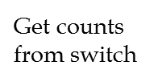
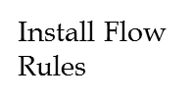
SINGLE SWITCH WORKFLOW
New Flow
6
Switch
1
Anomaly Detector
2
Statistics Collector
Detection Unit
Flow Manager
5
4
3
Cluster Manager

Slide 12

MULTIPLE SWITCH WORKFLOW
Cluster Manager
Switch-1
Detection Unit
Flow Manager
Switch -1
Statistics Collector
Anomaly Detector
Cluster Manager
Switch -2
Detection Unit
Flow Manager
Switch-2
Statistics Collector

Slide 13
EVALUATION PLAN
Ran some simple tests involving a tree topology
Still need to test for large volumes of traffic

Slide 14
EVALUATION – SCENARIO 1
s1
s2
s5
s3
s4
s6
s7
1
2
3
4
5
6
7
8

Slide 15
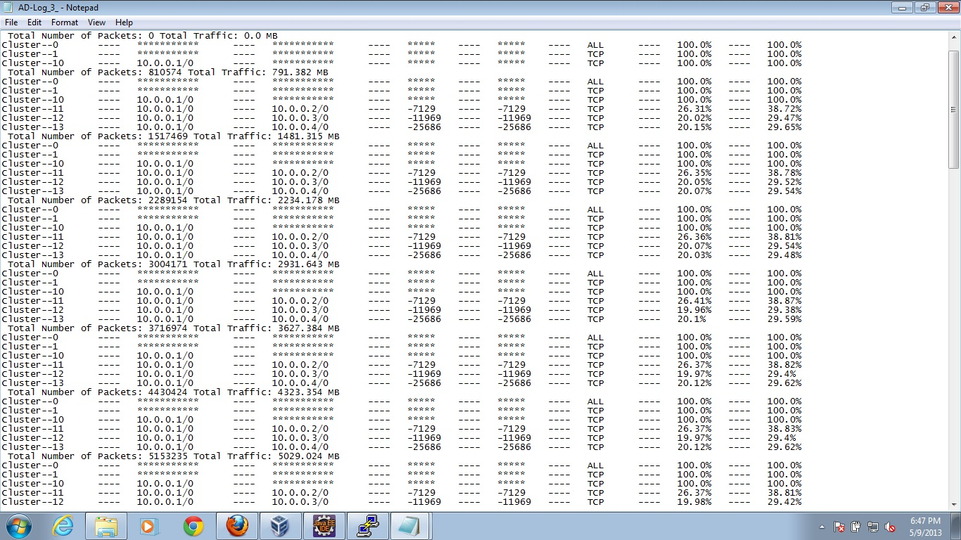
EVALUATION – SCENARIO 1

Slide 16
EVALUATION – SCENARIO 2
s1
s2
s6
s10
s3
s4
s5
s11
s12
s13
1
2
3
…
25
26
27

Slide 17
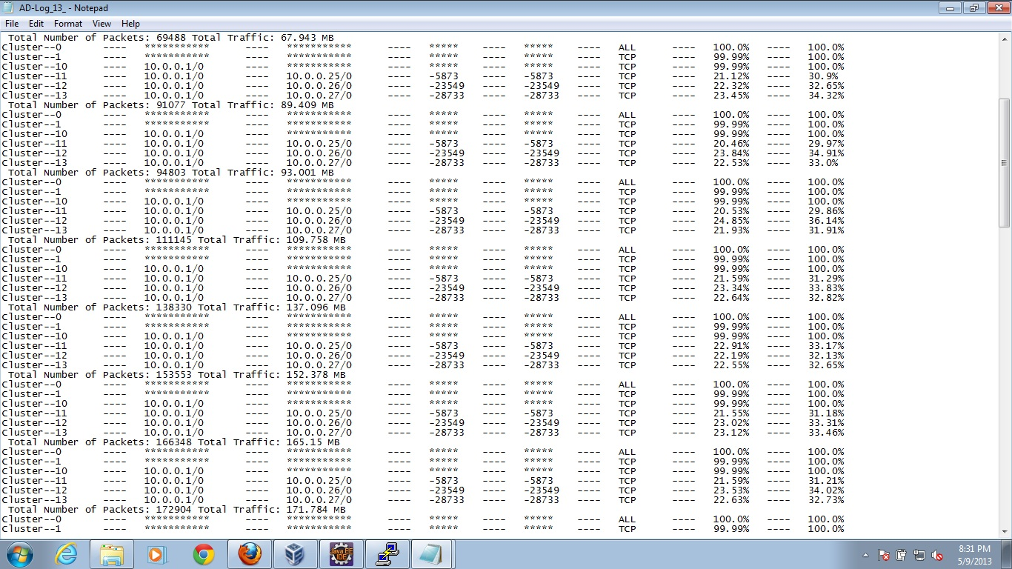
EVALUATION – SCENARIO 2

Slide 18
EVALUATION – SCENARIO 3
s1
s2
s5
s3
…
s6
s18
…
s21
1
2
3
4
…
61
62
63
64

Slide 19
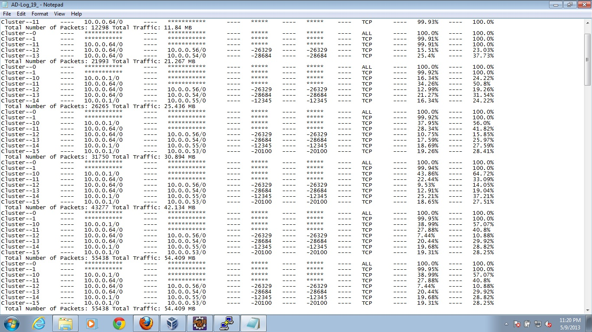
EVALUATION – SCENARIO 3

Slide 20
EVALUATION - TOOLS
Used mininet to create topologies using Python
Used iperf to generate traffic between the nodes

Slide 21
CURRENT STATUS
Current Implementation Is Based on The Laid-Back approach
It can detect anomalies based on signature or based on unusual traffic pattern
Generate meaningful concise report of traffic for a given period
Can work with multiple switches

Slide 22
FUTURE WORK
To do stress testing on the developed module
Test the ability to detect anomalies in a realistic network
Current implementation lacks cleanup. We will need to profile the module and integrate clean up logic accordingly
Multiple switches essentially generates multiple reports. It would be nice to combine all these reports to a single piece to speak for the entire network
A combination of Laid back + Aggressive Approach
Add a user interface (or simply text based configuration) to add / delete clusters

Slide 23
THANK YOU
GitHub Repository
https://github.com/bornogit/Floodlight-AD

